Slide 1
Sound Card Driving WAV & MP3 Playing
Project in Operating System

Slide 2
Who we are
Liu Junlin
Li Yinghui
Peng You
Liu Boge

Slide 3
Goals or User Stories
As a music zealot, I want to get music files stored in xv6, so that I can retrieve them anytime.
As a music zealot, I want to play music of mp3 or wav format on xv6, so that I can enjoy my life.

Slide 4
Motivation
Sound playing as a requirement for good OS
Charm of music
Willingness to take challenges
A great sense of achievement

Slide 5
Investigation
Previous documents
Introduction to WAV & MP3 format
Docs of xv6

Slide 6
Overall Design
声音播放
解码
原始文件读取
Modify the file system
Initialize the sound card
Decode the MP3 file
Implement a multi-process player
初始化声卡
mp3解码算法
扩展文件系统
多线程系统调用

Slide 7
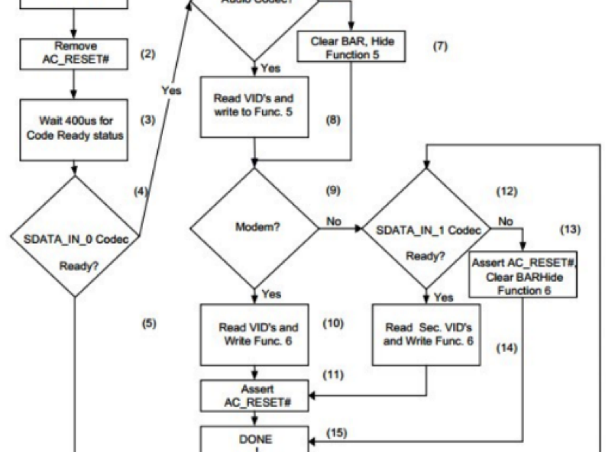
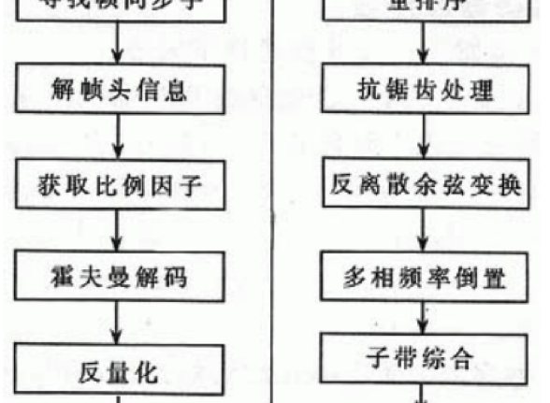
Process Diagram
Sound playing
MP3 decoding

Slide 8
Challenges
Interaction with hardware
Complication of decoding
Frame header decoding
Huffman decoding
Stereo handling
Lack of standard libraries

Slide 9
Solutions
Research relevant material more thoroughly
Utilize mature libraries from Internet
Draw on experience from seniors and TA
Beat difficulties by our bravery and persistence

Slide 10
Schedule
11.3 Get started
11.17 Do further research
12.1 Have basics done
12.31 Make sound heard

Slide 11
Thanks for listening
Q&A

